Slide 1
Inference Time Estimates
Device | Model | Inference time (second)
Laptop | Yolo8 nano | 1.74
Laptop | Yolo8 small | 1.97
Laptop | Yolo8 medium | 2.04
Raspberry Pi Zero | Yolo8 nano/small | Segmentation Fault
Raspberry Pi Zero | Open CV (CC) | 2.41
Laptop = 12th Gen Intel(R) Core(TM) i7-12650H 2.30 GHz

Slide 2
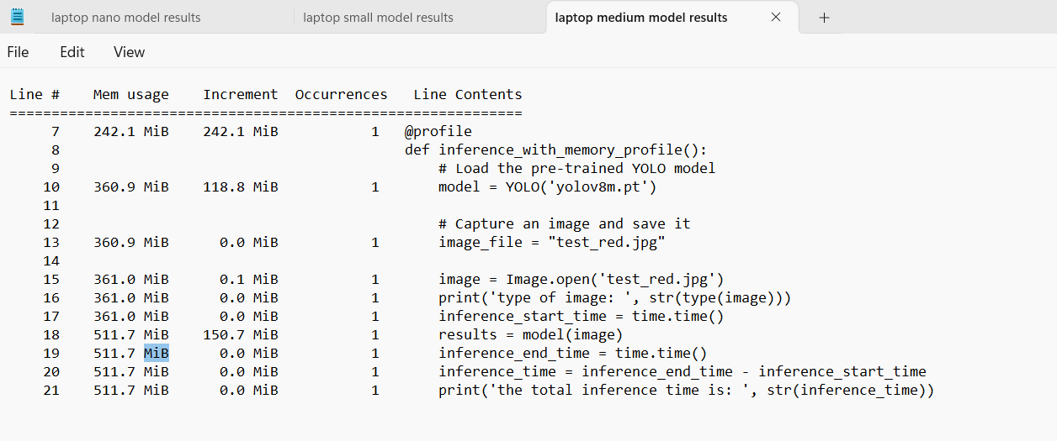
Memory Profiling
Model | Model load (MiB - MB) | Inference (MiB - MB)
Yolov8 nano | 19.2 - 20.6 | 96.7 - 101.4
Yolov8 small | 54.8 - 57.5 | 124.8 - 130.9
Yolov8 medium | 118.8 - 124.6 | 150.7 - 158.0
Open CV (CC) | 57.0 – 59.8 | 1.0 – 1.05

Slide 3
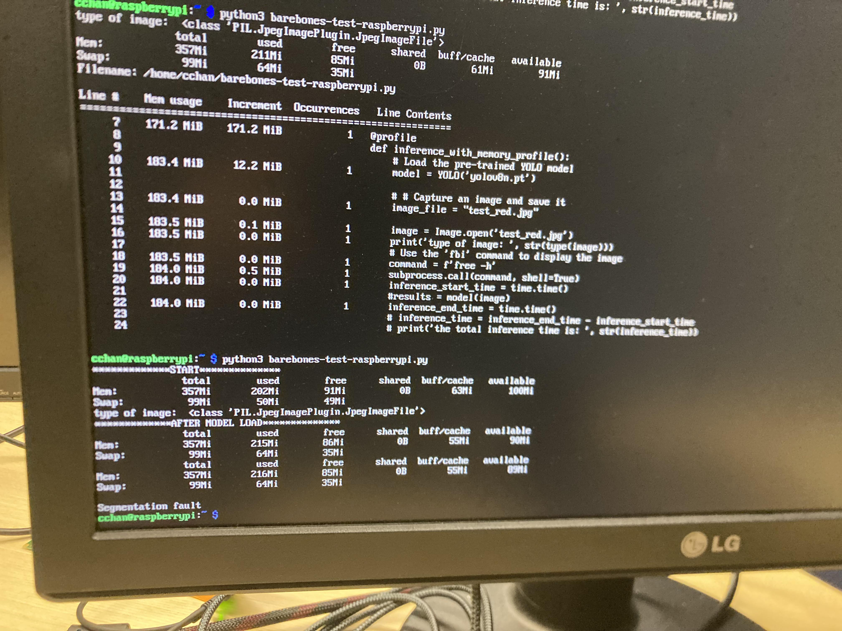
A puzzling situation...

